Slide 1
GovTech-Thon 2020
Armageddon - V
Team Members:
Atharva Bankar
Faiz Ansari
Lakshita Agarwal
Darshan Rander
Aryan Gandhi

Slide 2
Problem Statement
Artificial Intelligence (AI) based Alternate Crop or Crop Rotation proposition is desired for providing suggestions for alternate crops which may increase profitability of the farmers. The system may consider parameters of good agricultural practices. Obtain soil type, water requirement / availability, seasonal parameters (temperature ranges, humidity, etc.) along with location and advise the best crops suitable along with what is required (quality / quantity of seeds, fertilizers, pesticides, labor requirements, animal / machines), duration of cultivation, demand, cost of cultivation and expected revenues / profits.
Outcome: An application that takes required parameters intelligently or from the database of the location (from the cloud) and provides the list of best crops suited for that land. The application should also be able to collect the outcome after cultivation and apply correction as appropriate for further advisories.

Slide 3


Technology Stack
Cloud Computing:
Amazon SageMaker
AWS Lambda
API Gateway
Machine Learning / Artificial Intelligence:
XGBoost Classification Algorithm
Data Cleaning & Manipulation
App:
Flutter
Dart
Firebase
Packages Used:
App Development: Provider, Http, Figma, Geolocator
Machine Learning: Scikit-learn, XGBoost, Seaborn, Pandas

Slide 4
Dataset
The dataset used for the purpose of model training is extracted from data.gov. (check References section)
The data used consists of –
State, District, Season, Crop, Rainfall, Area under cultivation, Tubewell depth, Soil quality and the Soil type.
Data curation & cleaning is done so as to make it more apt for using.
The predictions are done on the column CROP, of the dataset. The dataset contains detailed information about productions of a particular crop in a given area under certain specific conditions and parameters.

Slide 5
Input and Output Parameters
Inputs:
Agricultural parameters such as – Energy source, Depth of tubewell, Area of field, Production of last year.
Location Details – State, District (tapped from GPS)
Environmental factors – District wise soil type, soil nutritional content, rainfall.
Deployment:
These parameters are then fed into the Machine learning model for training via AWS SageMaker.
Output:
The ML model outputs the probabilities of each crop that is suitable for the end-user i.e. farmer. The crops with highest probability are concluded as the best suitable crops that can be cultivated as alternative crops.

Slide 6
Methodology
The dataset obtained from various websites is compiled into one single curated dataset using data pre-processing techniques to be used for training the Machine learning model.
The Machine Learning model used for training the curated dataset is XGBoost.
The dataset is then split into training and testing data. The training is done on the training data and the model accuracy and predictions are obtained using the test data.
The XGBoost model is trained with multiple hyper parameters. For this purpose tuning of these parameters is performed. The tuned hyper parameters help in increasing the model accuracy.
Probabilities of each crops are computed on the cloud and sent to the app via the REST api.

Slide 7
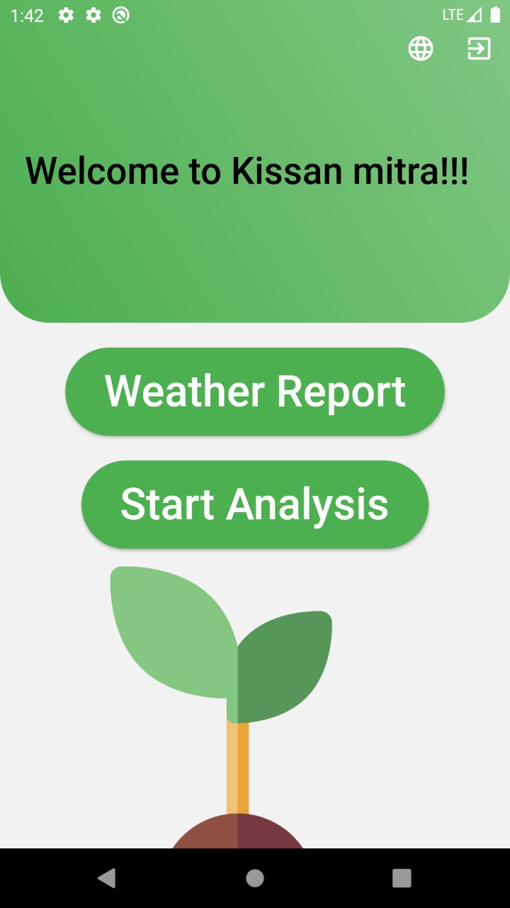

Application UI

Slide 8
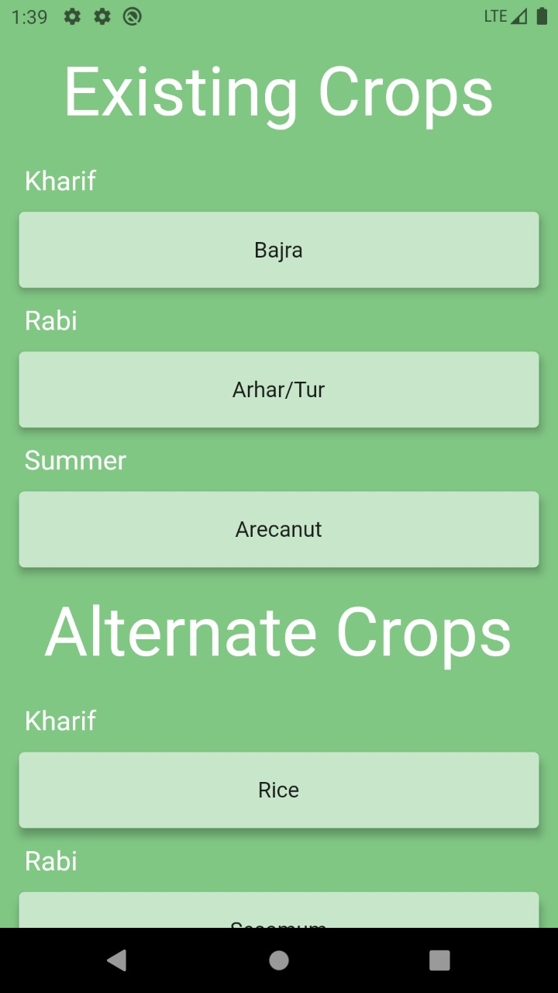
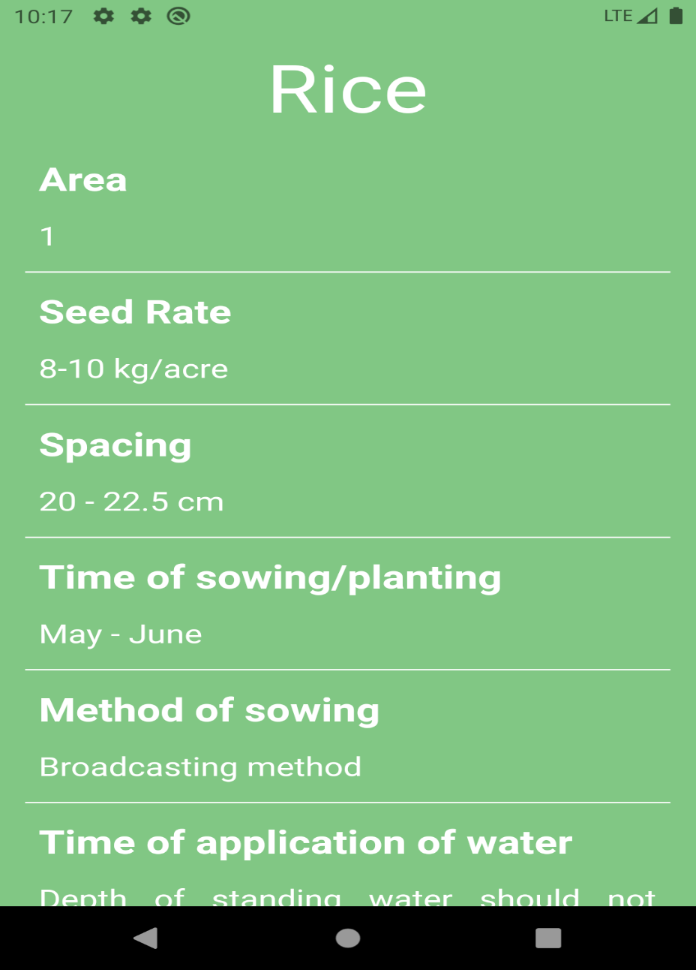
Application UI (contd.)

Slide 9
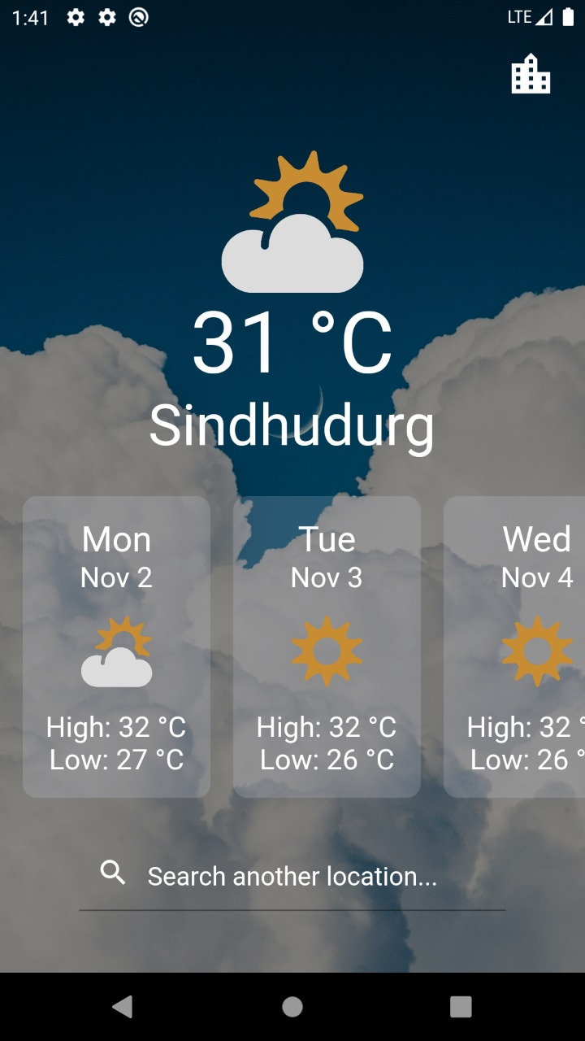
Application UI (contd.)

Slide 10
References
https://www.soilhealth.dac.gov.in/NewHomePage/NutriPage
https://data.gov.in/resources/district-wise-season-wise-crop-production-statistics-1997
https://data.gov.in/resources/commodity-wise-details-cost-msp-and-return-2017-18-2019-20-ministry-agriculture-and
https://data.gov.in/resources/district-wise-distribution-shallow-tubewells-according-depth-dugwell-4th-minor-irrigation
https://data.gov.in/resources/area-weighted-monthly-seasonal-and-annual-rainfall-mm-36-meteorological-subdivisions-1901
https://www.apnikheti.com/home

